Slide 1
FROG 3.0
INSTALLATION SCHEMA

Slide 2
Logical component location
Node
Controller
Orchestastrator
Network Node
Controller SDN (OpenDaylight)
Compute Node
OpenStack Controller
Virtual switches network
Virtual switches network

Slide 3


Network infrastructure
(Single Node)
Node
Controller
For simplicity both graphs and openstack control traffic exit by this eth
-
it has not its own IP address
Orchestrator
br-ex take its own IP address
Controller SDN (OpenDaylight)
L2 switch
br-ex
L2 switch
br
L2 switch
br-usr
L2 switch
br-int
br-usr is the vswitch where all users are connected
br-int is the vswitch where all openstack vms are connected
Management eth.
Useful in case, for some reasons, a loop involved the vswitchs network
-
it has its own IP address
Control and Management eth
-
it has its own IP address
Notes:
Connection between br-ex and br-int are made from Orchestrator for every single graph.

Slide 4
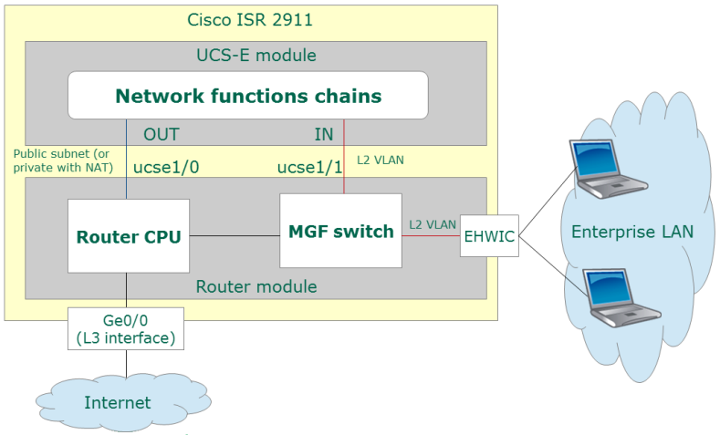
Router configuration

Slide 5
UCS configuration
Compute/network node
br-ex take its own IP address from dhcp or static
This eth has no ip address configured
L2 switch
br-ex
eth0
ucse1/0
br-int is the vswitch where all openstack vms are connected
L2 switch
br-int
L2 switch
br-usr
eth1
ucse1/1
br-usr is the vswitch where all users are connected
This eth has no IP address configured
eth2
ISR Router

